Slide 1

Project Evaluation

Slide 2

Problem Statement:
Predict/Recommend the customer segment for a new wine based on the wine shop dataset by performing dimensionality reduction
using LDA
Group Ng:
Chetan Samrit Darshana Nagpure Deepak Suryawanshi Suryadeep Khungar Yash Dorshetwar

Slide 3


Table of Contents
Introduction
What is customer segmentation? What is LDA?
Model Code API Overview
General API Working Components used in provided API
Process Workflow for API creation UI Workflow
Technology Stack Frontend Development Backend Development Database Managment

Slide 4

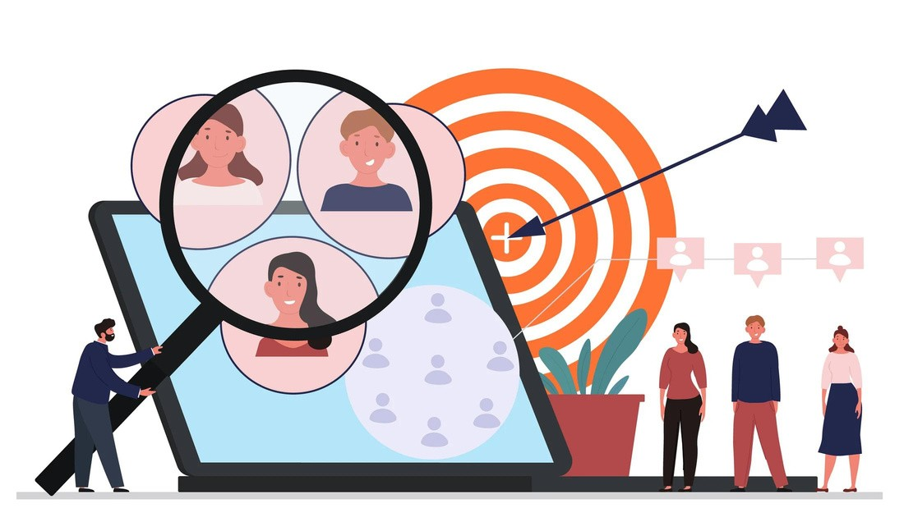
Introduction
Why is customer segmentation so important in the wine industry?
Well, simply put, it allows wineries to better understand their customers and tailor their products and marketing efforts accordingly.
What does our model provide?
Our model divides a customer base into groups of individuals that have similar needs
according to wine ingredients.

Slide 5
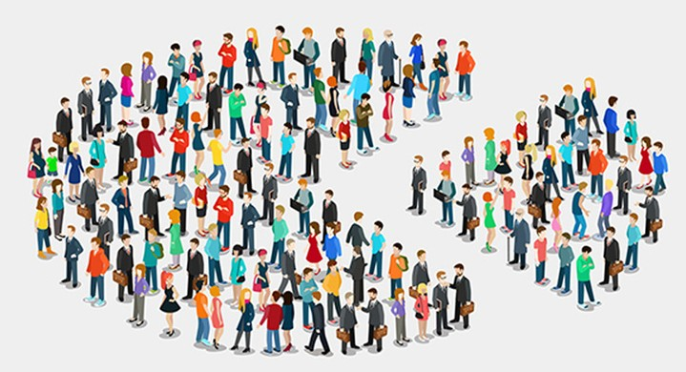
What is customer segmentation?
Customer segmentation is the process of dividing a customer base into groups of individuals that have similar needs or characteristics. By doing this, businesses can tailor their marketing efforts and product offerings to specific segments, resulting in increased customer satisfaction and loyalty.
In the wine industry, customer segmentation is especially important because wine consumers have diverse preferences and behaviors. For example, some customers may prefer red over white wine, while others may be more interested in organic or sustainably produced wines. By segmenting customers based on these preferences, wineries can develop targeted marketing campaigns and product offerings that meet the needs of each segment.

Slide 6
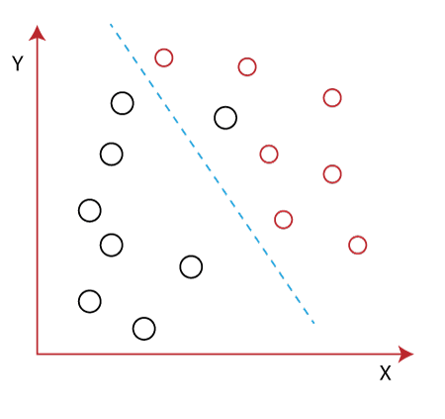
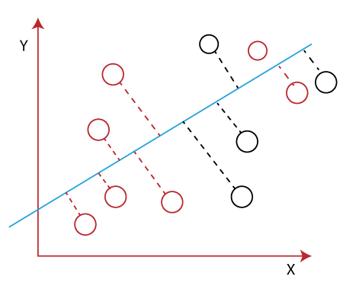
What is LDA?
Linear Discriminant Analysis (LDA) is a supervised learning algorithm used for classification tasks in machine learning.
It is a technique used to find a linear combination of features that best separates the classes in a dataset.
It provides an informative low- dimensional view on the data, which is both useful for visualization and feature engineering.

Slide 7
Linear Discriminant analysis is used as a dimensionality reduction technique in machine learning, using which we can easily transform a 2-D and 3-D graph into a 1- dimensional plane.
LDA enables us to draw a straight line that can completely separate the two classes of the data points. LDA uses an X-Y axis to create a new axis by separating them using a straight line and projecting data onto a new axis.
To create a new axis, Linear Discriminant Analysis uses the following criteria:
It maximizes the distance between means of two classes.
It minimizes the variance within the individual class.

Slide 8
Model
Importing the necessary libraries
Importing the dataset
Correlation Matrix
Correlation for Customer Segment column
Percentage of customer groups in the dataset
Pie chart visualization
Applying LDA
Logistic Regression
Predictions and Evaluations
Visualizing the Training and Test set results
Model Saving
Overall, the code performs exploratory data analysis, applies LDA for dimensionality reduction, trains a logistic regression classifier,
7. Scatter plot
8. Splitting the data into training set and evaluates the model, and saves the trained
test set
9. Feature Scaling
model for future use.

Slide 9
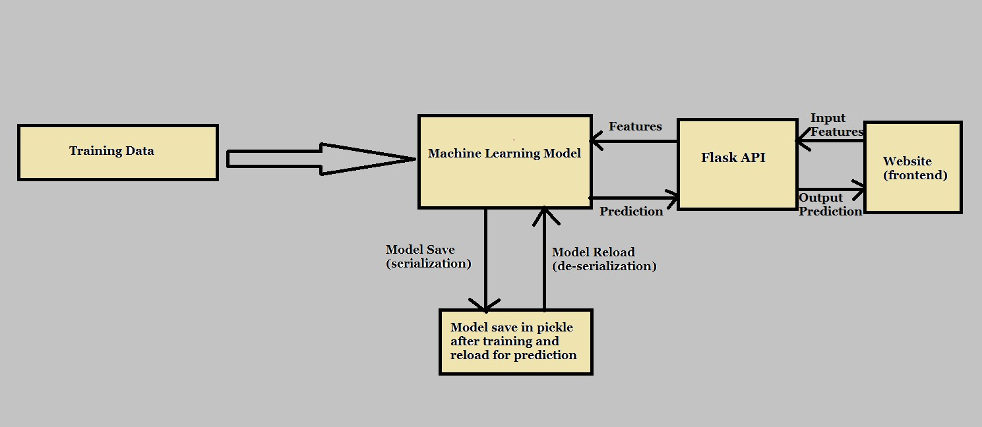
API Overview
Routes can be accessed in many ways, through what are known as methods or verbs
The most common verbs are GET and POST

Slide 10

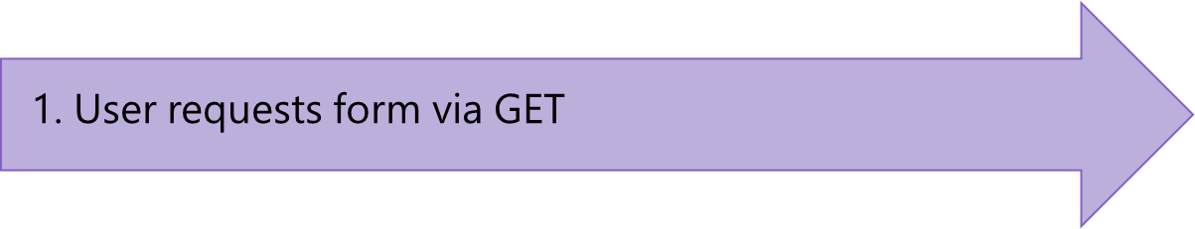

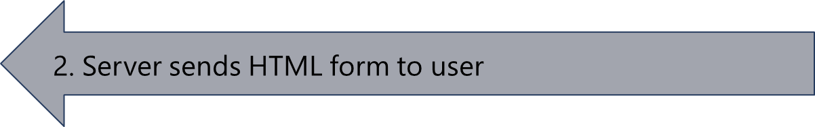
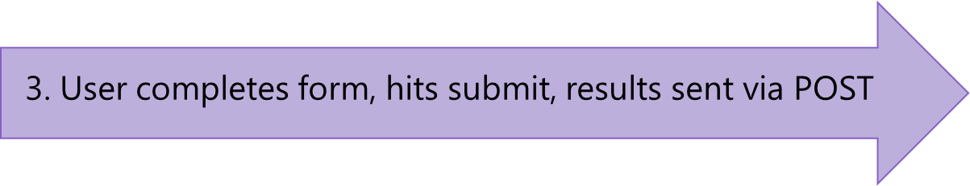
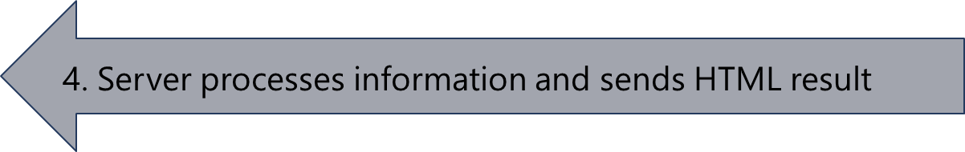
General API Working

Slide 11
@app.route('/', methods=['GET']) def index():
# send form to the user
return render_template('index.html')
@app.route('/', methods=['POST']) def index_post():
# process information, send results
return render_template('results.html', data=some_data)

Slide 12

Components Used in provided API
Flask Request Jsonify
Sci-kit Learn Numpy Pickle

Slide 13

Process Workflow for API creation
HTML Testing followed by React Testing
Import necessary modules and libraries like Flask, numpy, pickle, etc. Create Flask app
Load model files
Define customer segments
Define prediction endpoint( return render_template for html testing and /predict for react js testing)
Extract data from request Extract input features from data
Reshape input features array to match the expectations of the model
using numpy

Slide 14
Process Workflow for API creation
Apply scaling to the input features Apply LDA transformation
Make the predictions using the model
Return result as a list( for html ) / as json output being passed (for react js)
Run the flask app with debugging enabled

Slide 15

U I W O R K F L O W
Have an account
NO
SignUp
Fill out Information
YES
Login
Submit
Data stored in Database
Enter email and password
NO
Email and password valid ?
YES
Enter values related to wine content
Login to the home page
output

Slide 16



TECHNOLOGY STACK
Frontend
Backend
Database
React
react router dom axios
Express
cors
Node js
MySql
REACT
EXPRESS
MYSQL
Client Side /Frontend
Server side / Backend
Database

Slide 17
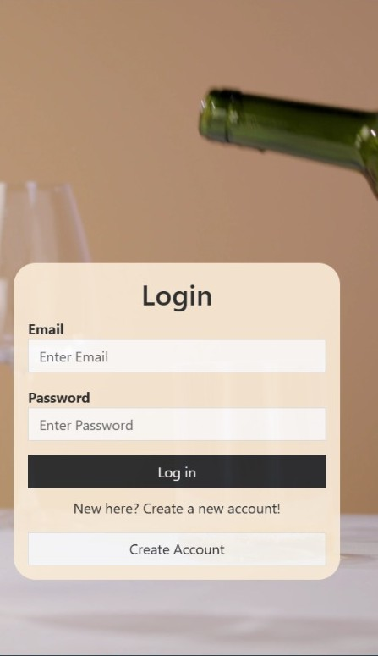
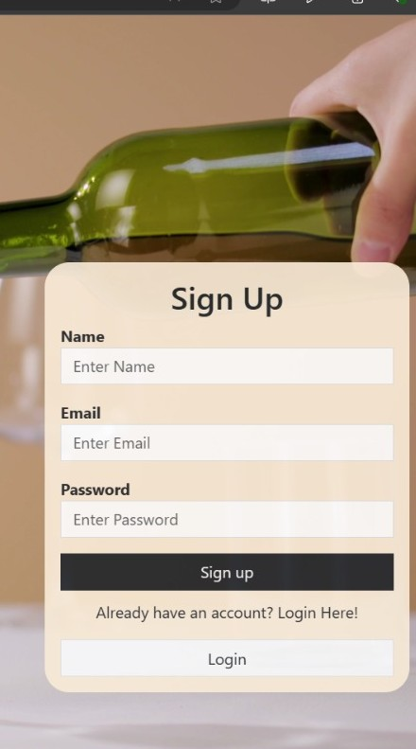
FRONTEND DEVELOPMENT
Login/Signup
React Component State Managment Validation Function Input Handling Form submission
Storing Data (Signup) Sending Request Handling Response Redirecting Rendering
CSS Styling

Slide 18
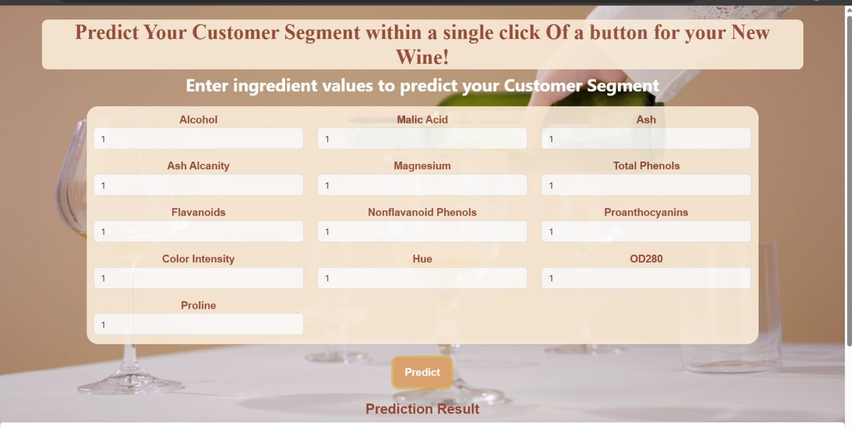
HOME PAGE
Home Component
State Managment Input Handling Prediction Request Server Request Displaying Prediction User Interface
Api integration

Slide 19
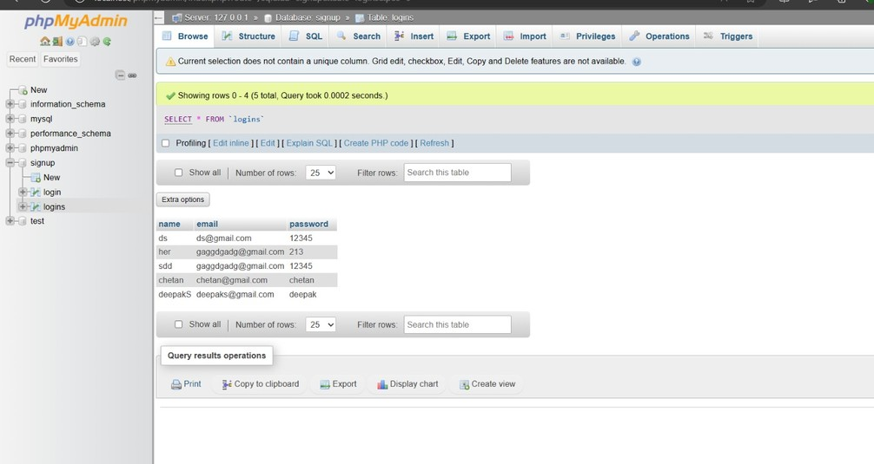
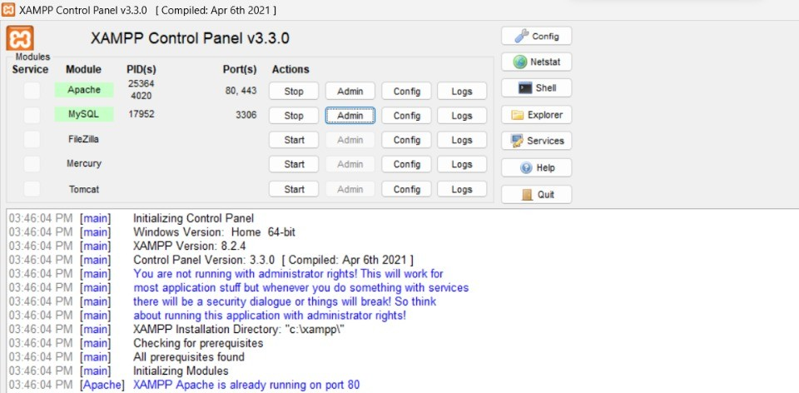
BACKEND DEVELOPMENT
DATABASE MANAGMENT
Importing Dependencies
Server Setup Mysql Connection Signup Endpoint Login Endpoint Query Execution Response Handling Server start
Install XAMPP
Start XAMPP and launch PHP My Admin
Create a database
create a table Write SQL query

Slide 20
Ideal Result
Crisp and Intense!
Your ideal customer segment should be 1
A taste that's elegant and sophisticated!
Your ideal customer segment should be 2
Subtle and Smooth!
Your ideal customer segment should be 3

Slide 21
THANK YOU

